Slide 1


DCJ Double Distance Approximation
Ron Zeira
ACGT 1.1.2014

Slide 2

Outline
Introduction & Motivation.
  Biological motivation.
  DCJ model.
  Duplicated genome models and problems.
  Previous results.
Double distance approximation.
  Computational aids.
  DD approximation on circular genomes.
  Result for Linear genomes*.

Slide 3
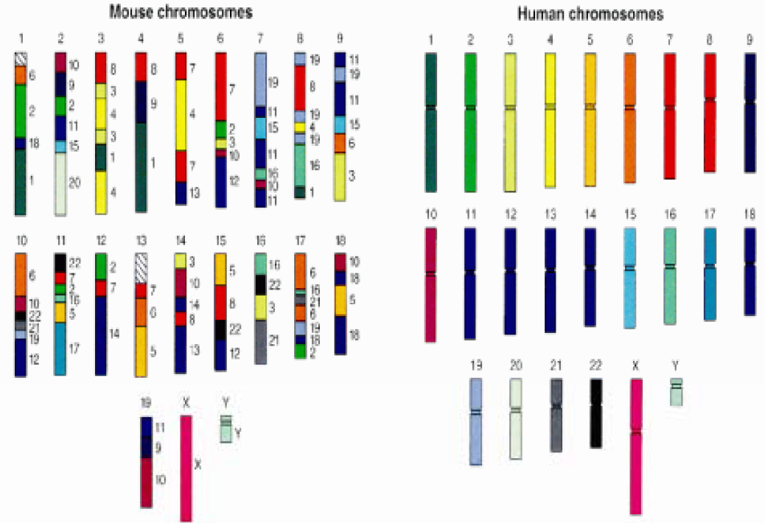
Biological motivation
Human genome project

Slide 4
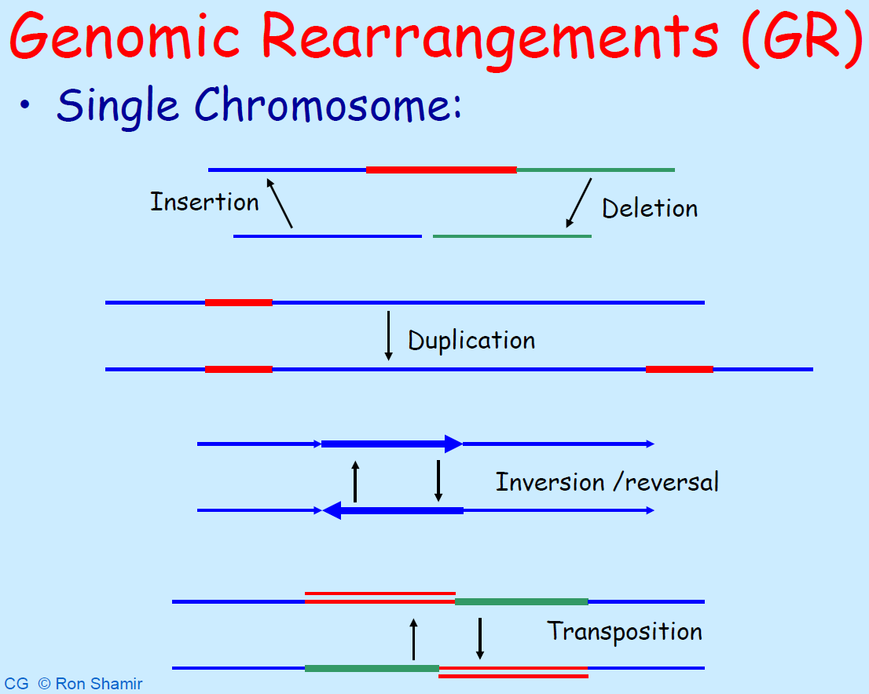
Computational Genomics
Prof. Ron Shamir & Prof. Roded Sharan
School of Computer Science, Tel Aviv University

Slide 5
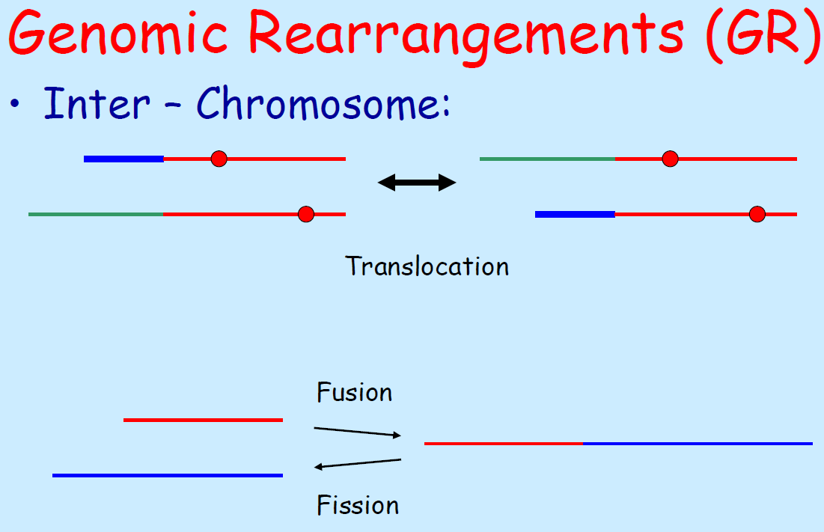
Computational Genomics
Prof. Ron Shamir & Prof. Roded Sharan
School of Computer Science, Tel Aviv University

Slide 6
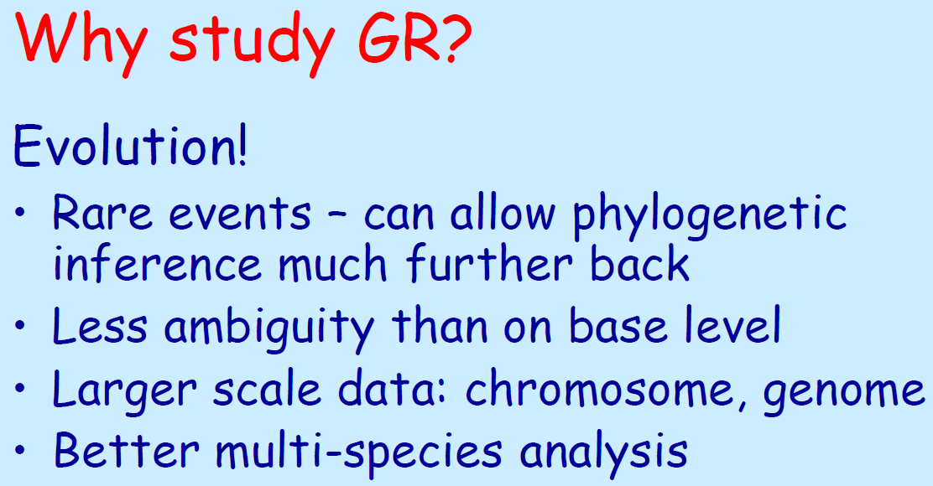
Computational Genomics
Prof. Ron Shamir & Prof. Roded Sharan
School of Computer Science, Tel Aviv University

Slide 7
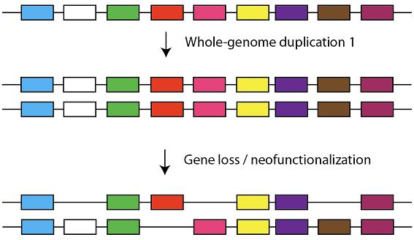
Whole genome duplication
Exactly what it sounds like!
Important source for genome evolution.
Redundant genes may be silenced or lost.
Particularly common event in plants.
WGD evidence found in yeast and vertebrates.
Evidence in mammalian under controversy.

Slide 8
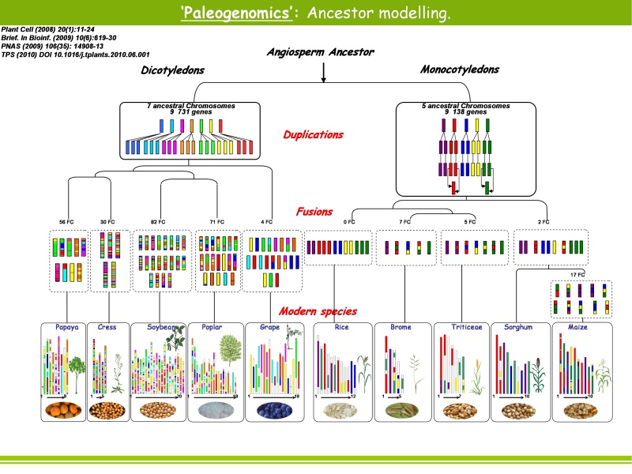
http://www4.clermont.inra.fr

Slide 9
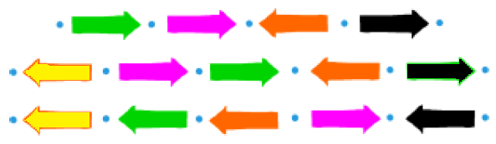
Genome representation
Oriented gene
Gene head
Gene tail
Adjacency
Telomere
Extremity

Slide 10
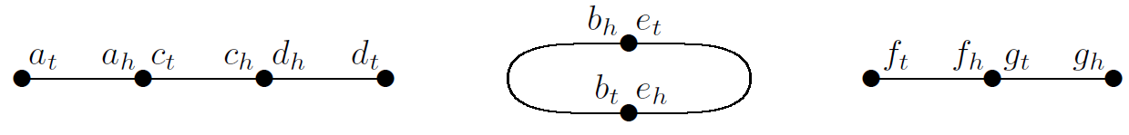
Example

Slide 11
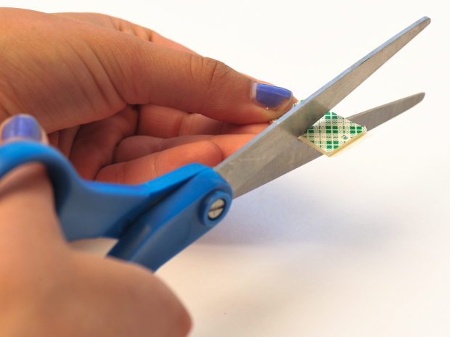
DCJ model
Yancopoulos et al. 2005.
Simplified by Bergeron, Mixtacki and Stoye 2006.
DCJ – Double Cut and Join:
  Cut the genome in 2 places.
  Join the 4 loose ends.

Slide 12
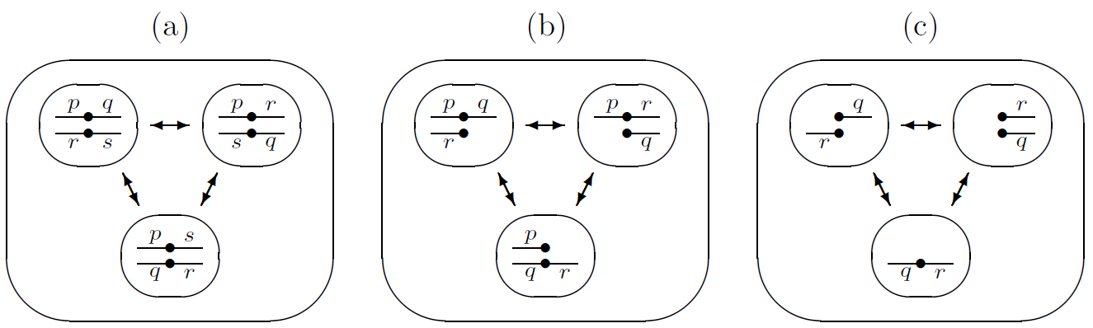
DCJ operation
A: {p,q},{r,s} → {p,r},{q,s} or {p,s},{q,r}
B: {p,q},{r} → {p,r},{q} or {q,r},{p}
C1: {r},{q} → {r,q},({})
C2: {r,q},({}) → {r},{q}
fusion
fission
translocations
translocations

Slide 13
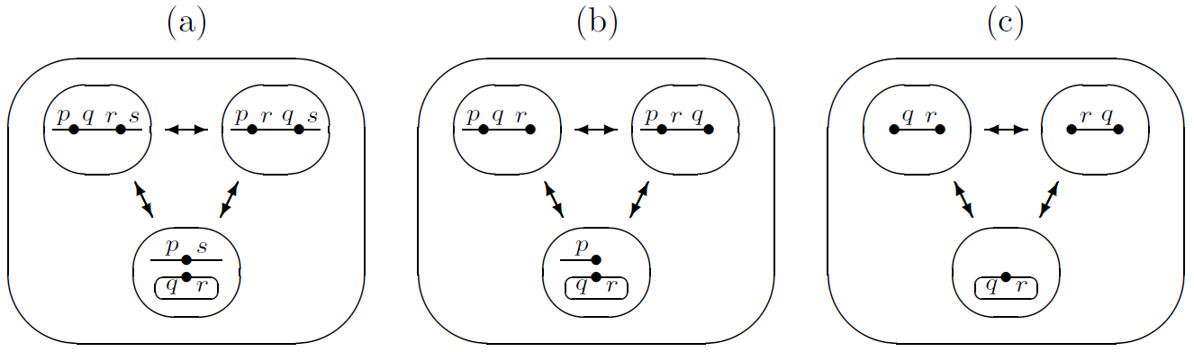
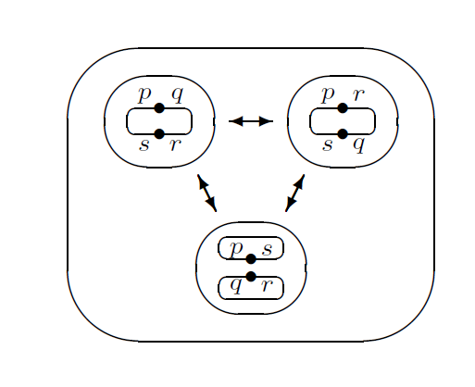
DCJ operation
inversion
inversion
inversion
circular excision
circular excision
circular excision
inversion
circular excision

Slide 14
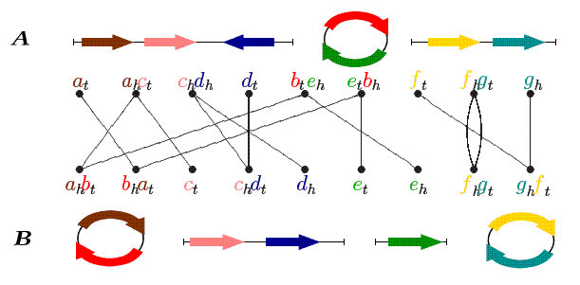
DCJ distance problem
Given 2 genomes, find the minimum number of DCJ operations to transform one genome into another.
The distance and sorting scenario solved in linear time (Yancopoulos et al. 2005).

Slide 15
Duplicated genomes
Singleton genome – exactly one copy of each gene.
Fully duplicated genome - every gene is present exactly twice.
Two copies (paralogs) for each gene x₁, x₂.

Slide 16
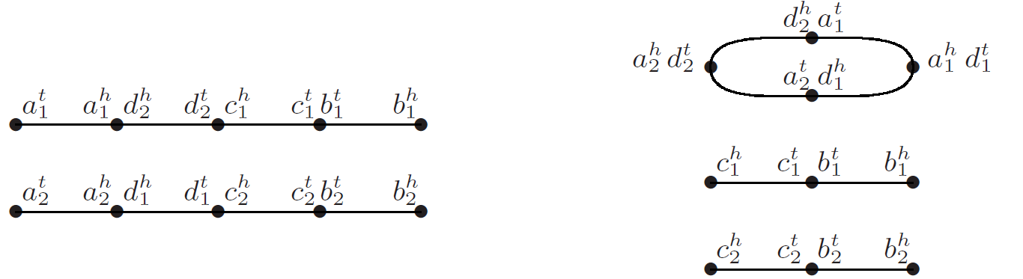
Perfectly duplicated genomes
G Perfectly duplicated genome of the singleton genome D if:
  For every linear chromosome in D there are two identical copies in G.
  For every circular chromosome C in D either
    Two identical copies of C in G.
    A circular chromosome in G that is a concatenation of two copies of C.

Slide 17
Perfectly duplicated genomes
Equivalent definition - Perfectly duplicated genomes:
  Each adjacency {p,q} in G, the paralogous adjacency {p̅,q̅} is also in G and p≠q̅.
  For each telomere in G, the paralogous telomere is also in G.

Slide 18
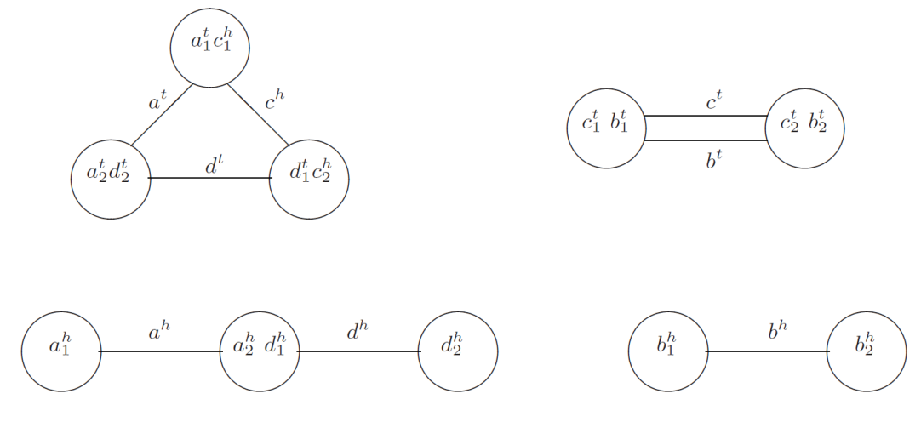
Computational problems
Halving – given a fully duplicated genome, find a perfectly duplicated genome with minimum distance.
The closest genome right after duplication.
The DCJ halving problem has a linear solution – Mixtacki 08’.

Slide 19
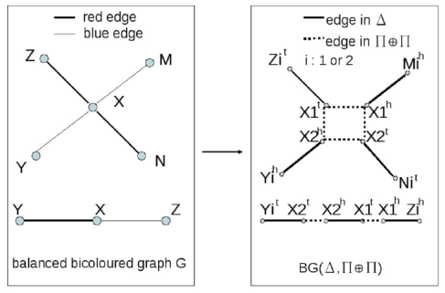
Double Distance Problem
Double Distance Problem – Given a fully duplicated genome Δ and a singleton genome Π find a perfectly duplicated genome Π⊕ Π that minimizes the DCJ distance.
Label genes 1 or 2 to minimize distance:
DDP is NP-hard for multichromosomal circular genomes (Tannier et al. 09’).

Slide 20
Previous work
Savard et al. 11’ – greedy heuristic for DDP. Partially duplicated genomes.
Hasic and Gavranovic 11’ – B&B exact DD on circular genomes. Approx algorithm with no bound. Analysis mistake.
Shao and Lin 12’ – poly algorithm 1.5+ℰ approx on model with unrestricted duplicated genes and indel operations.

Slide 21
This work
Correct the problem in Hasic and Gavranovic analysis.
Poly approx algorithm 1.5+ℰ factor (any ℰ>0) for DDP in circular genomes.
Extend the result for linear genomes.

Slide 22
k-set packing
k-set packing problem is a pair (U, ℱ) where U is a universe of elements and ℱ is a collection of sets of k elements.
The goal is to find a maximum cardinality subset of ℱ such that its sets are pairwise disjoint.

Slide 23
k-set packing
The problem is NP-hard for k>2.
The problem has a bounded degree d if every element belongs to at most d sets in ℱ.
For any ℰ>0 approximation ratio k/2+ ℰ in the general case and (k+1)/3+ℰ for the bounded case (Hurkens & Schrijver 89’, Halldórsson 95’).
Polynomial running time:

Slide 24
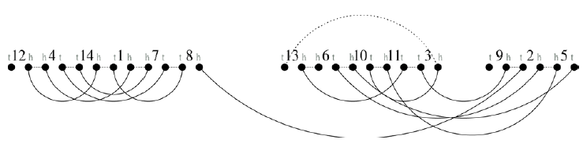





Breakpoint graph
The breakpoint graph of genomes Π and Γ:
  Nodes = Extremities.
  Edges: blue (dotted) edges between adjacent extremities in Π and red (plain) for Γ.
Tannier et al. 09’

Slide 25
Breakpoint graph & DCJ distance
A trail is alternating if consecutive edges have different colors.
Theorem (Tannier et al.) – for singleton genomes with n genes, c cycles and e even paths:

Slide 26
Generalized breakpoint graph
Generalized BG: All gene copies are the same.

Slide 27
BG decomposition
A decomposition of BG is a collection of edge-disjoint alternating paths and cycles that cover all edges.
Theorem (Hasic and Gavranovic) - for circular duplicated genomes, minimal DD ←→ maximal decomposition:

Slide 28
Analysis mistake
HG 11’ - there exists an optimal decomposition of BG that includes all 2-cycles and all 4-cycles.
True for 2-cycles, not for 4-cycles.

Slide 29
Circular BG decomposition
Claim: Every edge in BG belongs to at most 8 alternating 4-cycles.
Proof Sketch: consider edge (u,v)

Slide 30
Circular BG decomposition
Claim: The number of 4-cycles in BG is O(n³).
Proof sketch: three different nodes u,v,w.

Slide 31
Approximation
Lemma: finding a maximum set of disjoint 4-cycles in BG can be approx with 5/3+ℰ in O(n^{-3log}₄^{ℰ}) time.
Proof sketch: 4-set packing. Elements are edges and sets are cycles. The degree is bounded.

Slide 33
Approximation
Theorem : The algorithm gives a 1.5+ℰ approximation factor for the DDP on circular genomes in O(n^{-3log}₄^{ℰ}) time (ℰ>0).
Proof sketch:
  Optimal decomposition into r 2-cycles, p 4-cycles and q bigger cycles.
  Edge covering: 2n≥r+2p+3q .
  ALG gives |𝒮| 4-cycles: (5/3+ℰ )|𝒮|≥p.

Slide 34
Approximation

Slide 35
Linear genomes
Reduce to circular genome problem.
New null extremity 𝜏. Both head and tail of null gene.
Null adjacency is of the form {𝜏, 𝜏}.

Slide 36
Telomere removal
Telomeres: {x,○} → {x, 𝜏}
k₁>k₂ number of chromosomes in the 2 genomes: add k₁-k₂ null adjacencies {𝜏, 𝜏}.

Slide 37
Telomere removal
Theorem: Telomere removal procedure does not change the DCJ double distance.
Proof idea: any decomposition of the original BG into paths and cycles gives a decomposition of cycles in the new BG and vice-versa.

Slide 38
Approximation
Theorem: The DDP can be approximated within 1.5+ℰ of optimal in O(n^{-4log}₄^{ℰ}) time (ℰ>0).
Proof idea: similar analysis to the circular case. In general the set packing problem is not bounded.

Slide 39
Future work
Finish writing.
Extend results to DD with gene losses.
Implement and test on simulated data. Compare to heuristic of Savard et al. 11’ and B&B of Hasic and Gavranovic 11’.

Slide 40
?

